Slide 1
Retirement Income
Notes:
Instructor Note
The purpose of this presentation is to review how some of the common Box 7 codes on a 1099-R affect the return. Volunteers will be able to practice entering information in TaxSlayer. Discussion questions are included to help reinforce the tax law associated with retirement income and the volunteers will be directed to review key pages in publication 4012.

Slide 2
Retirement Income Topics Covered in this Presentation
General retirement income info
Federal retirement income topics
Normal distribution (1099-R Box 7 = Code 7)
Uses for Box 5
Public Safety Officer Health Insurance Premiums
Early distribution, exception applies (1099-R Box 7 = Code 2)
Early distribution, no known exception (1099-R Box 7 = Code 1)
Early distribution penalty
Exception to early distribution penalty (Form 5329)
Disability pension (1099-R Box 7 = Code 3)
Recipient under employer minimum retirement age
Recipient has reached employer minimum retirement agge

Slide 3
Retirement Income Topics Covered in this Presentation
cont’d
Transfers between retirement accounts
Direct IRA trustee-to-trustee transfers
Direct transfer from a qualified retirement plan to an IRA (Taxpayer does not receive money)
60-day indirect rollover (Taxpayer receives money)
Employee Federal after-tax contributions to pension
Taxable amount given on 1099-R
Taxable amount not given on 1099-R
Bogart annuity calculator for Simplified Method
Disability pension with employee Federal after-tax contributions to pension
Railroad Retirement Board (RRB) 1099-Rs
Qualified Charitable Distribution (QCD) from a Traditional IRA

Slide 4
Retirement Income Topics Covered in this Presentation
cont’d
NJ retirement income topics
Disability pension
Military pension
NJ 1040 lines to report retirement income
Separate lines for taxable and excludable amounts (Lines 20a and 20b)
3-year rule
Government pension with Federal pre-tax contributions
IRA with pre-tax contributions
Pension exclusion
Other retirement income exclusion
Qualified Charitable Distributions from an IRA

Slide 5
Types Of Retirement Income
Pensions & 457 plans
Including disability income post retirement age
Annuity/Insurance Contracts
Social Security
Railroad Retirement Benefits
Tier 1 – Social Security equivalent
Tier 2 – Pension equivalent
IRAs
401k, 403b, Thrift Savings Plans
Notes:
5

Slide 6
Retirement Income Definitions
Pension (including 457 plans):
Periodic payments made to employee (or survivor) after retirement from work
Annuity:
Payments received by taxpayer under contract from insurance company, trust company or individual
IRA (Individual Retirement Account):
Self-managed personal tax-deferred savings plan
401k:
Employer sponsored & managed tax-deferred retirement savings plan
403b:
Retirement savings plan for public education, some non-profit, cooperative hospital service organizations, and self-employed ministers
Notes:
6

Slide 7
IRAs – Individual Retirement Accounts
Different types of IRAs
Traditional IRA
IRA with deductible contributions
IRA with non-deductible contributions
Roth IRA
Simple IRA (Savings Incentive Match Plans for Employees) Out of Scope when contributions are made
SEP IRA (Simplified Employee Pension) Out of Scope when contributions are made
Notes:
7

Slide 8
Traditional IRA
Must have earned income & be < 70½ to contribute
Non-working spouse can contribute to IRA if filing MFJ and spouse works
Federal rules:
Contributions may be tax deductible in the year made
Current limit: $6,000 if less than age 50/$7,000 if 50 years or older
May be reduced based on retirement plan, filing status, income
Contributions can be made up to tax return due date & applied retroactively to tax year
Earnings accumulate tax deferred
Distributions taxable in the year received
Notes:
8

Slide 9
Traditional IRA
cont’d
Required Minimum Distribution (RMD) by April 1 following year taxpayer turns 70½
If first RMD is not taken until following year, will have to take two RMDs that year – one by April 1 and second by December 31
If full RMD not taken, 50% penalty for amount not withdrawn
NJ rules:
Contributions to IRA are not deductible in the year made
Therefore, contributions may not be taxable when distributed
Need records to show contribution amounts
Earnings accumulate tax deferred, but earnings taxed when distributed
Notes:
9

Slide 10
Traditional IRA with Non-Deductible Contributions
Non-deductible contribution is difference between permitted contribution and amount allowed for IRA deduction
Alternative when IRA deduction is limited due to retirement plan, income, filing status
Total of deductible + non-deductible cannot exceed maximum contribution limits ($6,000/$7,000 if 50 years or older)
Distributions from IRAs with non-deductible contributions
Deductible contributions taxed on distribution
Non-deductible contributions not taxed on distribution
Earnings are taxed on distribution
Notes:
10

Slide 11
Traditional IRA with Non-Deductible Contributions
(cont’d)
Non-deductible contributions must be tracked on Form 8606 and filed with tax return at time of contribution in order to be tax exempt on distribution
Distributions from IRAs with non-deductible contributions can be very complex, so refer to experienced counselor
Refer to Special Topics document “IRA Non-Deductible Contributions and Distributions” on TaxPrep4Free Preparer page
Notes:
Instructor’s Notes:
Form 8606 allows the client to track the non-deductible contributions
Creates a basis
Should be completed and sent to IRS
Client should bring to tax appointment
If clients didn’t fill out an 8606 when contributing year by year, it is possible to file the form late (with penalty of $50/yr)
If you don’t have 8606 filed by the time you take distributions, it’s too late to file it and you can’t get the benefit of tax-free distribution
11

Slide 12
Roth IRA
Can include:
After-tax contributions
No age limit for contributions, but must have earned income
Dollar limits on contributions same as for Traditional IRA ($6,000/$7,000 if age 50 or older)
Money converted from a Traditional to Roth IRA
No income limits for who can convert
Pay tax when contribution is converted
1099-R looks like a normal distribution
Notes:
12

Slide 13
Roth IRA
cont’d
No Required Minimum Distribution (RMD)
Amounts withdrawn from Roth IRA cannot be used to satisfy RMD for Traditional IRA
Earnings accumulate tax free (not just tax deferred)
Distributions are generally not taxable
Exception: Distribution within 5-yr qualifying period from date Roth IRA was first established may be subject to tax on earnings plus 10% early distribution penalty
Rules for taxability of distributions are the same for NJ
Notes:
13
Instructor Notes:
Explain that “tax free” means never having to pay tax; “tax deferred” means you can put off paying the tax, but you must pay tax in the future

Slide 14
401k Plans
Employer-sponsored plans
Pre-tax contributions (99.9% of cases)
If any contributions were after-tax (unusual), distributions are Out Of Scope
Earnings accumulate tax deferred
Distributions taxable in the year received
Required Minimum Distribution (RMD) by April 1 following the first year after the later of:
Year taxpayer turns 70½ OR
Year in which taxpayer retires
Contributions have also been pretax in NJ since 1/1/84
Notes:
14

Slide 15
Penalties Associated with IRAs
Early distribution penalty (prior to age 59½ )
10% of amount withdrawn if no exception (discussed in later slides)
Excess contributions penalty – Out of Scope
Additional tax - 6% of excess contribution for as long as excess remains in IRA
Failure to take full Required Minimum Distribution (RMD) penalty
Counselor not expected to review all plans and verify that required distributions were taken
Notes:
15

Slide 16
Penalty for Failure to Take RMD
Can request waiver if:
Taxpayer missed taking all or part of RMD
Shortfall in amount of distribution due to reasonable error
Taxpayer is taking reasonable steps to remedy shortfall
Use Form 5329 Part IX to request waiver
Enter waiver request in Federal Section \ Other Taxes \ Tax on Early Distribution Form 5329
Notes:
16

Slide 17
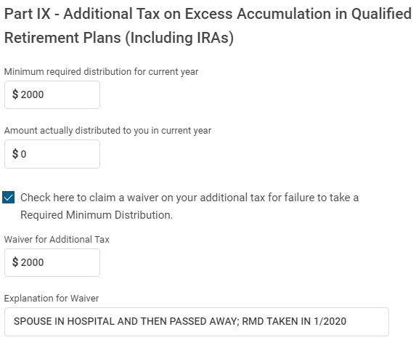
Waiver Request for Failure to take RMD Federal Section> Other Taxes >Tax on Early Distribution (Form 5329)
cont’d
RMD that should have been taken
Amount actually taken
Waiver for additional tax
Explanation for waiver
Notes:
17

Slide 18
Types of Retirement Income Tax Forms
1099-R | Pensions, Annuities, Retirement Plans, Insurance Contracts, IRAs
SSA-1099 | Social Security Payments
RRB-1099 | Social Security Equivalent or Tier 1
RRB-1099-R | Non-Social Security Equivalent or Tier 2 (Annuities/Pensions from Railroad Retirement Board)
Notes:
18

Slide 19
Exploring Form 1099-R
Log in to TaxSlayer
Begin a new return for Harriet Jones

Slide 20
Enter Filing Status, Personal and Dependent Information
Harriet:
Lawyer
Divorced since 2017
Date of birth 05/01/1963
Phone: 904-565-1256
Filing Status: Head of Household
564-00-xxxx
05/01/1963
One Dependent
Daughter: Candace Jones
SSN: 564-00-0011
Date of Birth 02/12/2004
Single, high school student
Lived with mom 12 months

Slide 21
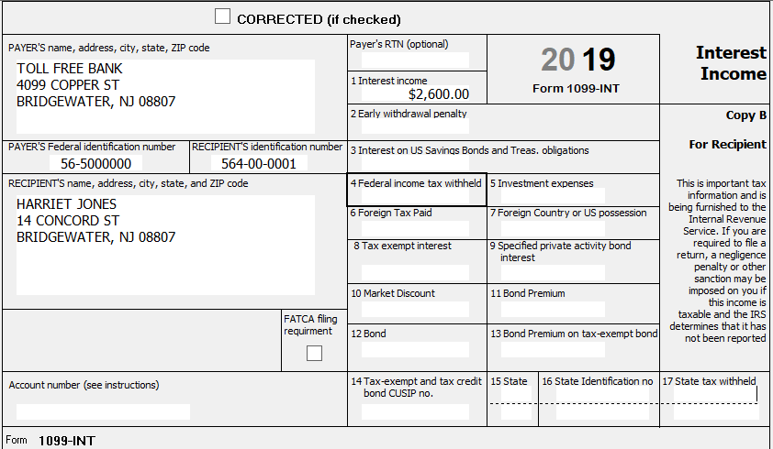
Enter 1099-INT
Notes:
Instructor Notes:
Add interest income

Slide 22
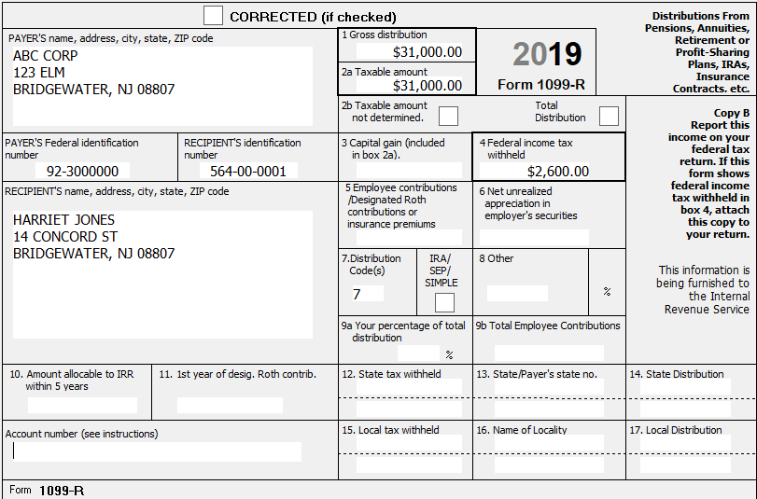
Enter 1099-R – Box 7 = Code 7 Normal Distribution
If Box 2a is given, use that as Taxable Amount even if Box 2b Taxable Amount Not Determined is checked
Notes:
Instructor Notes:
This is a normal distribution where taxable amount of distribution is given

Slide 23
Results – Normal Pension

Slide 24
Box 5 on 1099-R
Can be used for multiple purposes
For commercial annuity, Box 5 could show amount of taxpayer’s money being returned, so not taxable
Box 1 – Box 5 = Box 2a Taxable amount of distribution
Can be amount of employee’s contributions to pension being recovered in current year, so not taxable (discussed more later)
Box 1 – Box 5 = Box 2a
Can be amount of health insurance premiums deducted from pension
Frequently seen on Civil Service pensions (CSA-1099, CSF-1099)
Can be Public Safety Officer health insurance premiums (discussed more later)
Probe with taxpayer to determine what Box 5 represents

Slide 25
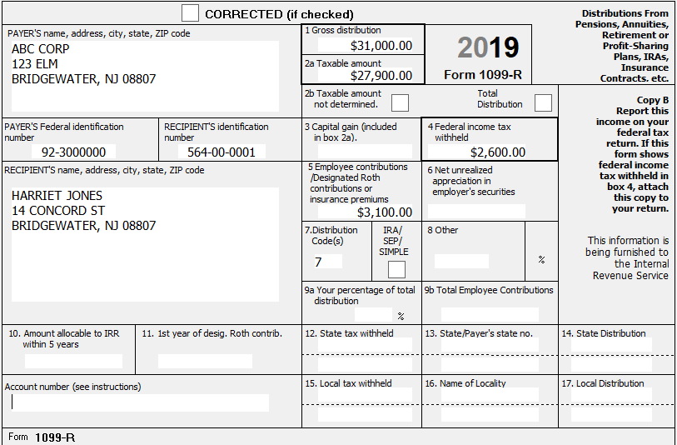
1099-R for Commercial Annuity
In some situations, taxable amount can even be zero
Box 1 – Box 2a = Box 5

Slide 26
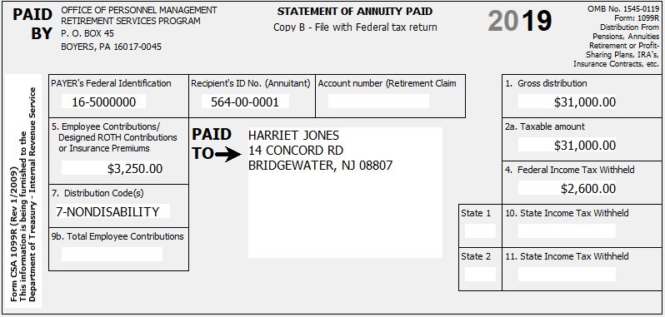
1099-R for Civil Service Pension
Box 5 is showing
Health Insurance Premiums

Slide 27
Box 5 for Public Safety Officer (PSO)
Box 5 for PSO may contain accident, health or long-term care insurance premiums that are deducted directly from pension check
PSO is allowed up to a $3,000 reduction in taxable income for insurance premiums
Amounts entered as nontaxable cannot also be included on Schedule A as medical expenses
Excess over $3,000 can be claimed as medical on Schedule A
Since NJ does not allow PSO to reduce taxable income for these premiums, they can be claimed as medical expenses on NJ return

Slide 28
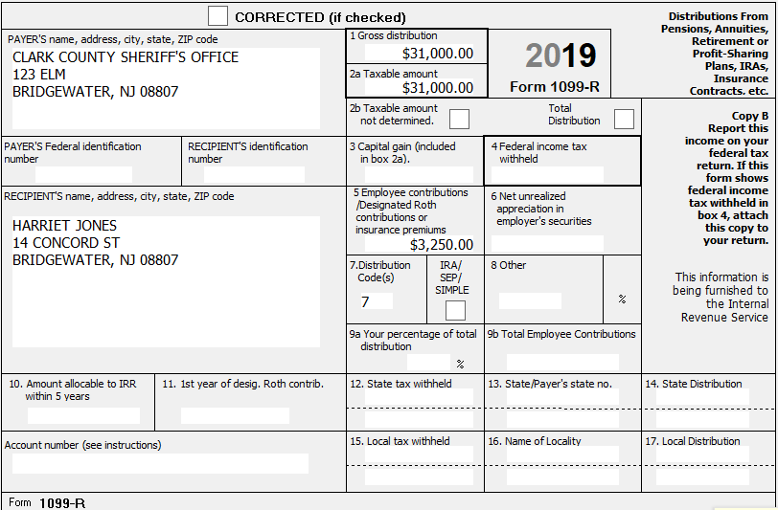
Change 1099-R and Schedule A to Reflect PSO Pension and PSO Health Insurance Premiums
For PSO health insurance,
can deduct up to $3,000
from taxable income
$250 added to Sch A medical expenses
so they will flow through to NJ return

Slide 29
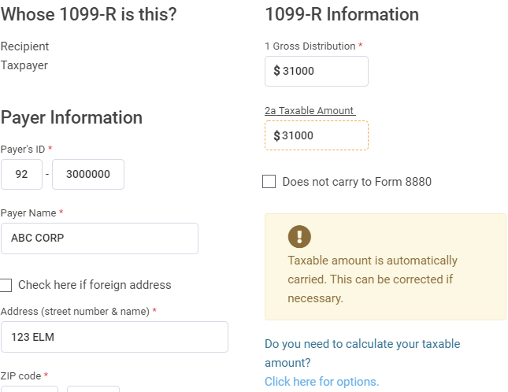
TSO 1099-R Screens to Enter PSO Health Insurance Premiums
TSO will change taxable amount in Box 2a to $28,000

Slide 30
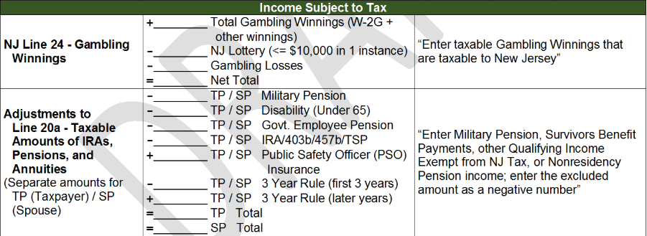
Enter PSO Health Insurance Entries on NJ Checklist and into TSO State Section
Capture premium amount (up to $3,000) in NJ Checklist Income Subject to Tax and Subtractions from Income sections
$3,000
To add premiums back into taxable NJ Pension income on Line 20a, since cannot be excluded for NJ (+$3,000)
$3,000
To add premiums to NJ medical expenses (+$3,000); $250 premiums on Schedule A will flow through to NJ return

Slide 31
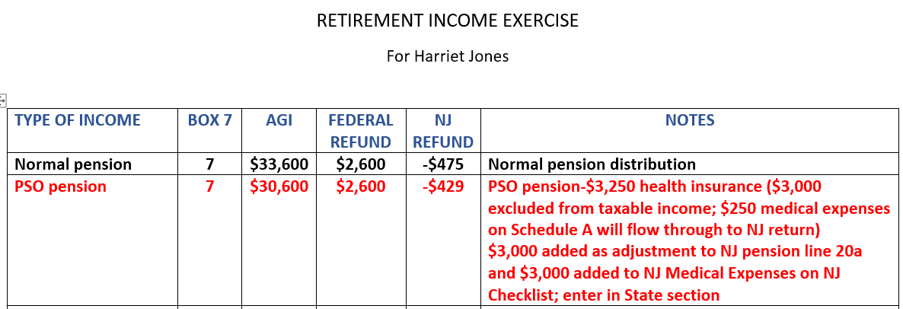
Results – PSO Pension
NOTE: After this step, change PSO health insurance premiums, Schedule A medical premiums and NJ Checklist entries back to 0

Slide 32
1099-R - Early Distribution, Exception Applies (Box 7 = Code 2)
Where can we find the Codes?
Back of the form (very small print)
Pub 4012 Page D-39
Box 7 Code 2 means Early Distribution – Exception Applies
Taxpayer under 59 ½ when distribution is taken
Payer is aware of early distribution penalty exception
TaxSlayer knows not to apply 10% early distribution penalty

Slide 33
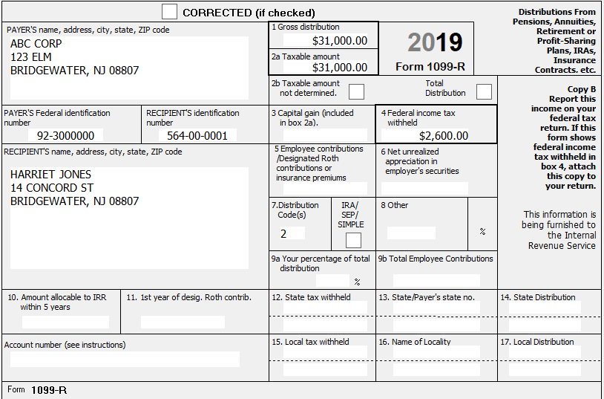
Change 1099-R to Reflect Early Distribution, Exception Applies (Box 7 = Code 2)
Early Distribution,
exception applies
Notes:
Instructor Notes:
This is an early distribution, exception applies

Slide 34
Results – Early Distribution, Exception Applies (Box 7 = Code 2)

Slide 35
1099-R - Early Distribution, No Known Exception (Box 7 = Code 1)
Box 7 Code 1 means early distribution – no known exception
After entering 1099-R, tell TaxSlayer distribution came from a retirement plan
TaxSlayer calculates 10% penalty on Sch 2 Line 6
Can manually enter exception on Form 5329
Enter exception amount and reason
Exception can apply to just part of distribution

Slide 36
Change 1099-R to Reflect Early Distribution, No Known Exception (Box 7 = Code 1)
NOTE: This is a distribution from an IRA; IRA box checked in Box 7
Notes:
Instructor Notes:
Note that the IRA box is checked in Box 7 to show that this is a distribution from an IRA

Slide 37
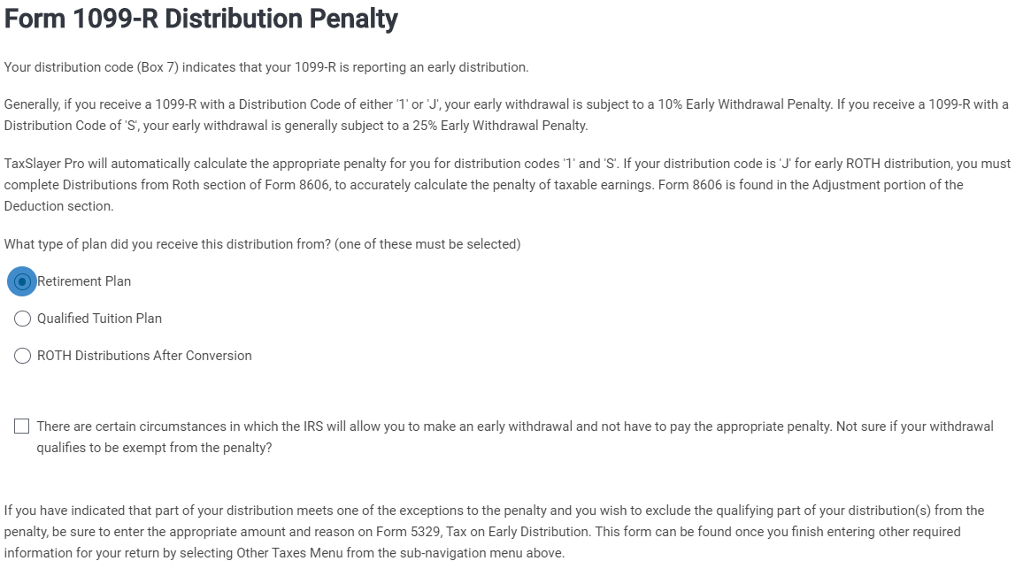
Form 1099-R Distribution Penalty Screen

Slide 38
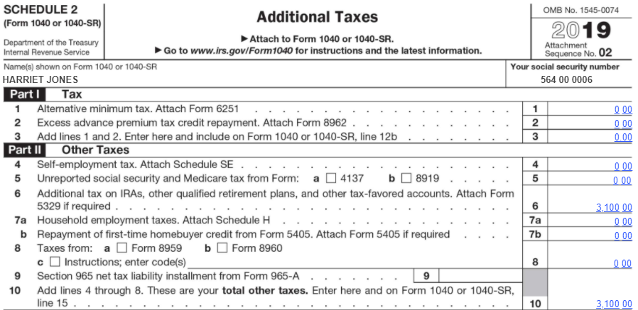
Early Distribution Penalty – Schedule 2 Line 6

Slide 39
Results – Early Distribution – No Known Exception (Box 7 = Code 1)

Slide 40
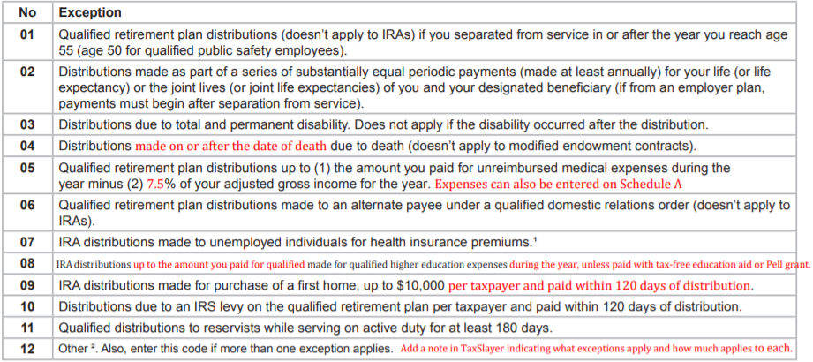
Exception Codes for 10% Early Distribution Penalty – Pub 4012 Page H-5
$20,000 of withdrawal used for college expenses for Harriet;
$11,000 used to pay credit card debt
Notes:
Instructor Notes:
Exception reason codes are on 4012 Page H-4
Note that some exceptions only apply to IRA distributions; some don’t apply to IRA distributions
Remember when the money is withdrawn and when the exception occurs does not always have to happen at the same time. For example, if the money is withdrawn in February to pay some normal household bills and then in September they incur several medical expenses in excess of the Schedule A threshold, the exception still applies. Note however, that would not be the case if the person became disabled in September.

Slide 41
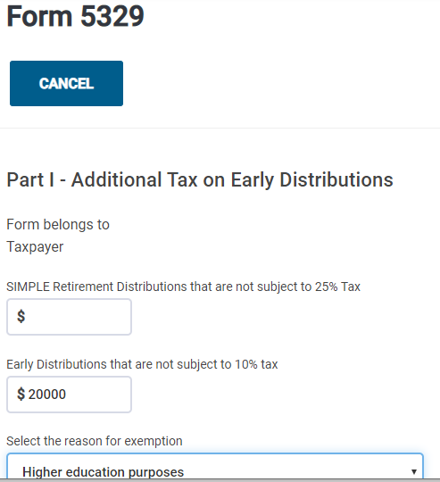
Enter Exception to Additional Tax on Early Distribution on Form 5329
Notes:
Instructor Notes:
Note that you can apply for an exception for only part of the early distribution penalty or for the entire penalty. In this case, $2000 of the early distribution was used to pay college tuition.

Slide 42
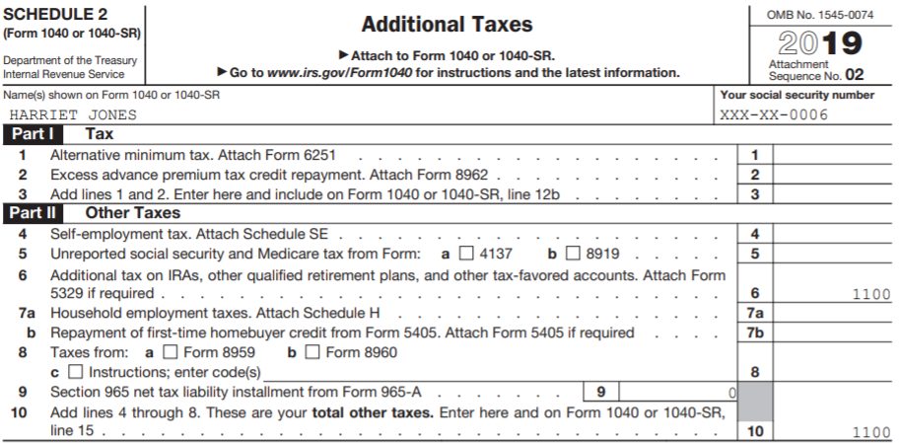
Early Distribution Penalty – Schedule 2 Line 6

Slide 43
Results – Early Distribution – Exception Code 08
Notes:
Instructor Notes:

Slide 44
Code 1 - Exception for Medical Expenses
Alternate Situation:
Harriet indicates that she used part of her IRA withdrawal to pay a bill for $10,500 for hospital and ambulance costs associated with an accident in March 2019 that were not covered by her insurance
How could this affect her return?

Slide 45
Exception Codes for 10% Early Distribution Penalty – Pub 4012 Page H-5
$10,500 for medical expenses
Medical expenses can still
be claimed on Schedule A
Notes:
Instructor Notes:
Exception reason codes are on 4012 Page H-4
Note that some exceptions only apply to IRA distributions; some don’t apply to IRA distributions
Remember when the money is withdrawn and when the exception occurs does not always have to happen at the same time. For example, if the money is withdrawn in February to pay some normal household bills and then in September they incur several medical expenses in excess of the Schedule A threshold, the exception still applies. Note however, that would not be the case if the person became disabled in September.

Slide 46
Form 5329 for Medical Expenses
What exception code would she use?
Code 05
How much of the distribution is subject to the exception?
The exception amount is the amount paid for unreimbursed medical expenses minus 7.5% of adjusted gross income (AGI)
$33,600 (AGI) X 7.5% = $2,520
$10,500 - $2,520 = $7,980 can be exempted from 10% penalty
$31,000 - $7,980 = $23,020 is still subject to 10% penalty
$23,020 X 10% = $2,302 penalty
Notes:
Instructor Notes:
Note that the exception for Medical Expenses states, “Qualified retirement plan distributions up to (1) the amount you paid for unreimbursed medical expenses during the year minus (2) 7.5% of your adjusted gross income (AGI) for the year.”

Slide 47
1099-R Disability Pension (Box 7 = Code 3) –Federal Rules
If recipient is under employer minimum retirement age, distribution is considered wages
Check box on 1099-R screen that says, “Check here to report on Form 1040, Line 1”
Can be considered earned income for EIC purposes
After recipient reaches employer’s minimum retirement age, distribution is considered pension income
Reported on 1040 Line 4b
Notes:
Instructor Notes:
This is a disability pension. Probe to find out the minimum retirement plan for the company that the taxpayer retired from.
Note the box that must be checked to move income to the Wages (earned income) line

Slide 48
NJ Rules for Disability Pension
Disability pension is taxed differently in NJ depending on age of recipient
Recipient under age 65 – disability pension is tax exempt; not reported on NJ 1040
Recipient age 65 or older – disability pension is treated as a regular pension
No matter whether disability pension is treated as wages or pension on the Federal return, it flows through to NJ Taxable Pension Line 20a
If under 65, must capture on NJ Checklist under Income Subject to Tax section to subtract from NJ taxable income
If 65 or older, do nothing further; leave on Taxable Pension line 20a
Notes:
48

Slide 49
NJ Rules for Disability Pension
If disability should be tax exempt because recipient is under age 65, capture the disability pension as a negative amount in the NJ Checklist Income Subject to Tax section
Notes:
49

Slide 50
Change 1099-R to Reflect Disability Pension (Box 7 = Code 3)
NOTE:
Delete Form 5329
Delete the check in the
IRA box
Check line that says “Check here
to report on 1040 Line 1”
Notes:
Instructor Notes:
This is a disability pension.

Slide 51
TSO Warning Regarding Disability Pension

Slide 52
Why Did Refund Increase So Much?
No additional withholdings, so why did Federal refund increase so much (+$2,738)?
Disability pension reported as wages counts as earned income. So now eligible for Earned Income Credit (EIC) on 1040 Line 18a
Why did NJ go from balance due to refund (+$941)?
Only NJ income is now interest; disability is not taxable for NJ if recipient is under 65
Eligible for NJ EITC (39% of Federal EIC), even though no NJ earned income

Slide 53
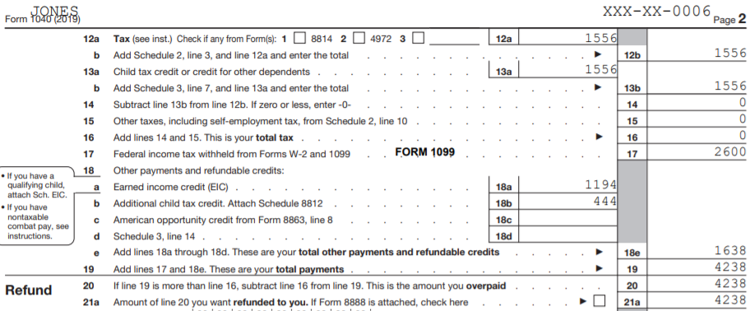
Earned Income Credit (EIC) on Federal 1040

Slide 54
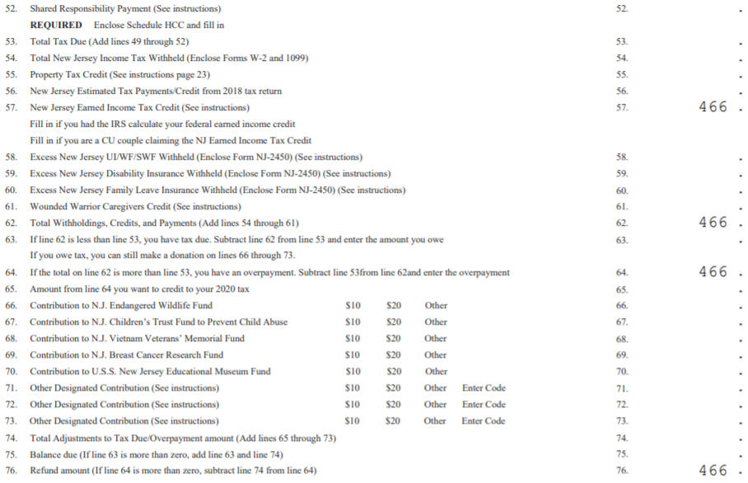
Earned Income Tax Credit (EITC) on NJ 1040

Slide 55
Results - Disability – Under Minimum Employer Retirement Age

Slide 56
Enter Additional Interest Income. What Happens?
Harriett says she expects her interest income to double next year and wants to know how that will affect her return
Edit the 1099-INT by doubling the interest to $5,200
What happens?
Obviously, her AGI increases by $2,600
Why did her Federal refund decrease so dramatically (-$1,506)?
Hint – Refer to Pub 4012 Page I-3
Investment income is now too high, so no EIC
Why did NJ refund also decrease (-$466)?
NJ EITC is a % of Federal EIC

Slide 57
Results – Interest Doubled
Notes:
Instructor Notes:
Don’t forget to change the interest income back to $2,600 after this step

Slide 58
Change 1099-R to Reflect Disability – Reached Employer Minimum Retirement Age
Change interest back to $2,600 first
Uncheck 1099-R box “Check here to report on Form 1040, Line 1”
Notes:
Instructor Notes:
In this scenario, the taxpayer has reached minimum retirement age for the company. The disability pension is now reported as a regular pension on 1040 Line 4b
No longer reported as wages
No longer has earned income for EIC

Slide 59
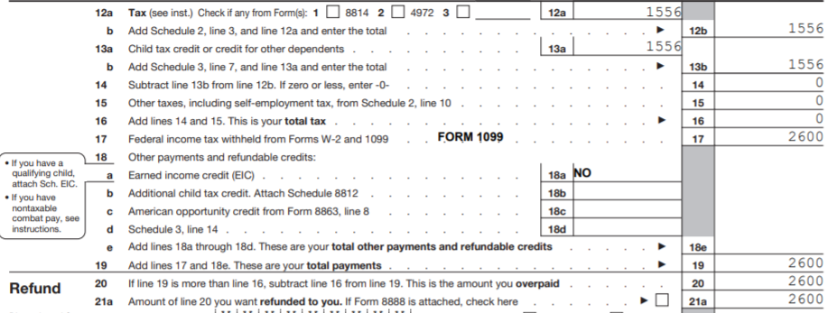
Federal 1040 – No Tax Liability
Why does Jones have $0 tax liability now? Why are all withholdings now a refund?
Nonrefundable Child Tax Credit now zeroes out tax liability
Why doesn’t Jones get Additional Child Tax Credit?
Needs at least $2,500 of earned income

Slide 60
Rollovers
Money transferred from one tax-deferred account into another (e.g. – 401k to IRA or one IRA to another IRA)
Entries on tax documents and treatment in TaxSlayer depend upon circumstances of transfer
Counselor needs to fully understand what occurred
Three common scenarios we see
Direct IRA trustee-to-trustee transfer
Direct transfer from a qualified retirement plan like a 401k to an IRA (Taxpayer does not receive money)
60-day indirect rollover (Taxpayer receives money)
Notes:
Instructor Notes:
Discuss the different ways the taxpayer can transfer money from one tax-deferred plant to another
Discuss how the distribution would be reported by the trustee
Discuss the rules that must be followed in each scenario
Discuss potential issues that could arise
60

Slide 61
Direct IRA Trustee-to-Trustee Transfer
Transfer of assets from IRA under one trustee to IRA under a different trustee without taxpayer ever taking control of money
No limit on how many can be done in one year since not officially considered a rollover
Can be done electronically (receiving trustee requests from original trustee) or distribution check can be issued in name of receiving trustee (not in taxpayer’s name)
Not reported on 1099-R
Not a taxable event; nothing in TaxSlayer
Receiving trustee does not issue a Form 5498 to show how much was received
Notes:
Instructor Notes:
The easiest way for a taxpayer to transfer money from one trustee to another is to go to new trustee & ask for this to be done electronically
61

Slide 62
Direct Transfer from a Qualified Retirement Plan to an IRA (Taxpayer Does Not Receive Money)
Transfer of assets from a qualified retirement plan (e.g. – 401k) into an IRA (or another qualified retirement plan) - Taxpayer does not receive money
Reported on 1099-R with Code G in Box 7
TaxSlayer handles automatically
Form 5498 may be issued by receiving plan with amount received in Box 2
Do nothing with Form 5498 in TaxSlayer
Notes:
Instructor Notes:
Situation usually happens when taxpayer retires and moves money from the company’s 401k into an IRA so that he/she can control investment choices
62

Slide 63
Indirect 60-Day IRA Rollover (Taxpayer Receives Money)
Assets in IRA are withdrawn via check made out to taxpayer; funds are re-deposited with another trustee
Original trustee reports distribution on 1099-R as a normal distribution (code 7) since it does not know what taxpayer will do with the money
If re-deposited in another IRA within 60 days, considered non-taxable
Can make only one rollover from one IRA to another or one Roth IRA to another Roth IRA in any 12-month period, regardless of the number of IRAs owned
If more than one rollover, distributions after first become taxable. May incur 10% early withdrawal penalty if under age 59 ½. Out of scope for us
Notes:
Instructor Notes:
This frequently happens when taxpayer goes to original trustee, closes out IRA, and then goes to a new trustee to open a new IRA
63

Slide 64
Indirect 60-Day IRA Rollover (Taxpayer Receives Money)
cont’d
Limit does not apply to direct Trustee-to-Trustee transfers, conversions from traditional to Roth IRAs, or transfers between IRAs and qualified retirement plans (or vice versa)
Reported on 1099-R with Code 1 or 7 in Box 7
Enter 1099-R into TaxSlayer as usual
Enter taxable amount in Box 2a (amount not rolled over)
Check box that says, “Check here if all/part of the distribution was rolled over, and enter the rollover amount”
Enter the amount rolled over. TaxSlayer will not include that amount on 1040 Line 4b as taxable
Notes:
64

Slide 65
Indirect 60-Day IRA Rollover (Taxpayer Receives Money)
cont’d
First, let’s try a rollover of the entire 1099-R amount
What do we enter in Box 2a?
How do we tell TaxSlayer that this is a rollover?
Now let’s try a scenario where half the distribution is rolled over and the other half is used to pay down credit card debt
What do we enter in Box 2a?
What is the rollover amount?
Why doesn’t the Federal refund change?
Notes:
65

Slide 66
Results – Rollover of Entire or Partial Distribution – Box 7 = Code 7
Note: Ignore early distribution penalty for this example

Slide 67
Employee Federal After-Tax Contributions to Pension
Employee who made Federal after-tax contributions to a pension
Contribution amount will be shown in 1099-R Box 9b
Upon distribution:
The portion of the distribution relating to the employee’s contributions has already been taxed and can be excluded from taxable income
The portion relating to employer’s contributions or earnings has not been taxed yet
Amount to exclude from taxable income is calculated based on amount of employee contributions and average life expectancy as of age when pension payments started
If Joint and Survivor Annuity, combined ages of taxpayer and spouse are used
Notes:
Instructor Notes:
Explain that the distribution amount includes employee’s contributions, employer’s contributions, and earnings
Employee’s contributions were taxed when put in. Employer’s contributions and earnings have been accumulating tax deferred
Discuss the concept of amortizing the employee’s after-tax contributions shown in Box 9b

Slide 68
Employee Federal After-Tax Contributions to Pension - Taxable Amount of Distribution Given on 1099-R
Payer may calculate the excludable part of the distribution and subtract it from the gross amount in Box 1
Box 2a will show the remaining taxable amount of the distribution
Box 5 will frequently show the current year’s excludable amount
Difference between Box 1 and 2a
In this situation, just enter 1099-R as is

Slide 69
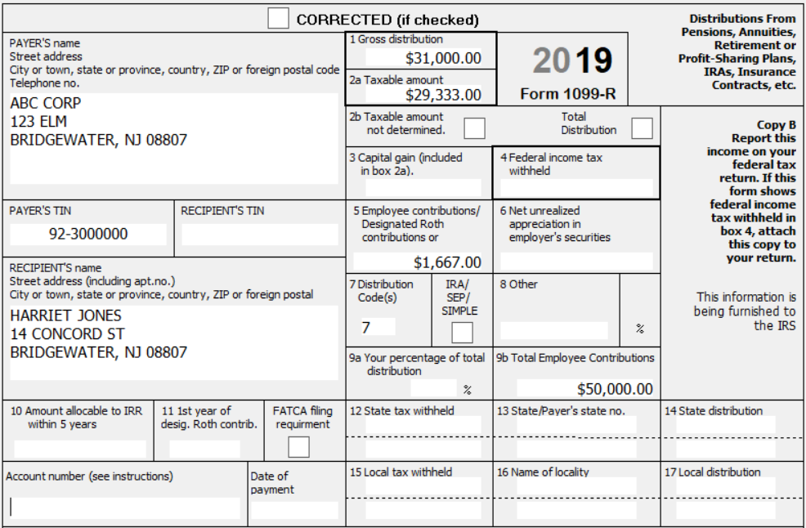
Change 1099-R to Reflect Employee Federal After-Tax Contribu- tions to Pension - Taxable Amount of Distribution Given
Delete rollover
check mark and
amount
Box 1 - Box 2a
= Box 5

Slide 70
Employee Federal After-Tax Contributions to Pension - Taxable Amount of Distribution Not Given
If payer does not show taxable amount in Box 2a, counselor must calculate how much is excludable
Box 9b shows total amount of employee Federal after-tax contributions to use in this calculation
Use Bogart Annuity Calculator link on TaxPre4Free.org Preparer page to calculate excludable amount
Notes:
Instructor Notes:
Demonstrate how to find the Bogart Annuity calculator on TaxPrep4Free
Explain why the Bogart calculator is preferable to the TaxSlayer Simplified Worksheet

Slide 71
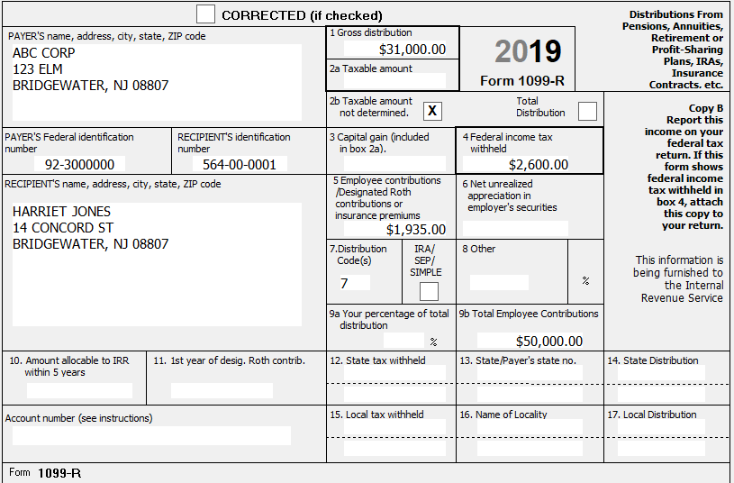
Change 1099-R to Reflect Employee Federal After-Tax Contribu- tions to Pension - Taxable Amount of Distribution Not Given
Notes:
Instructor Notes:
This is a pension where taxable amount must be calculated using the Bogart Annuity Calculator
The employee’s after-tax pension contributions are shown in Box 9b

Slide 72
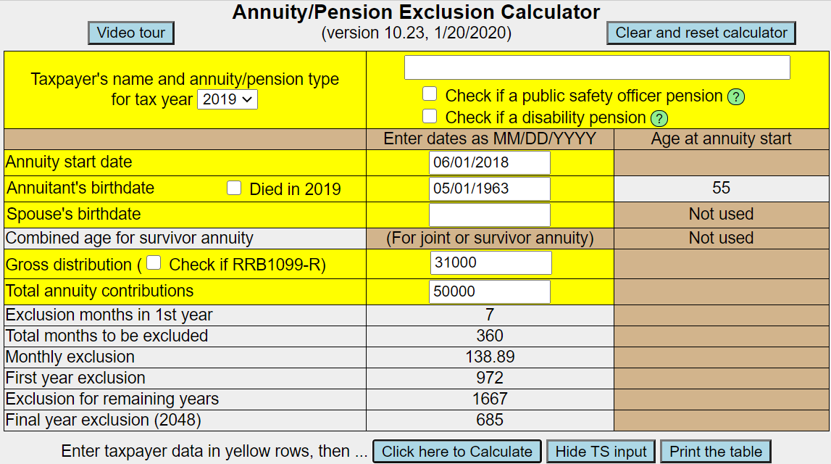
Simplified Method Calculation Using Bogart Annuity Calculator
Notes:
Instructor Notes:
Discuss what needs to be entered into the Bogart calculator
Discuss why it is preferable to use the Bogart calculator over the TaxSlayer Simplified Method Worksheet
Have students complete the entries themselves

Slide 73
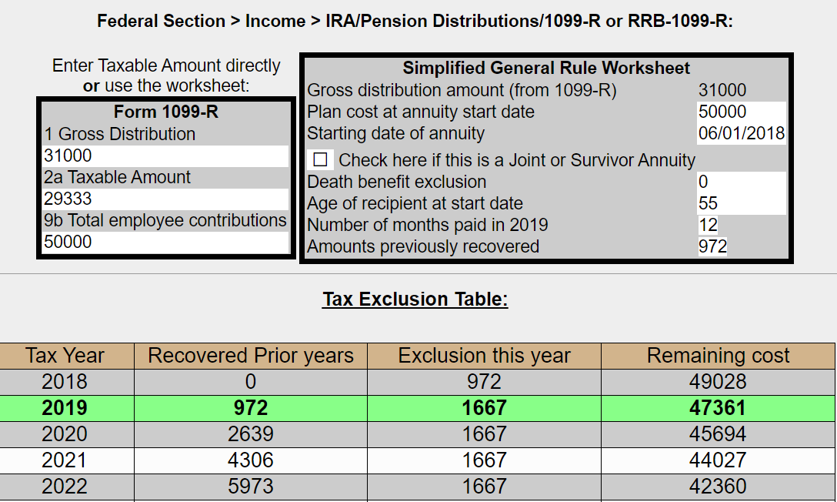
Simplified Method Calculation Using Bogart Annuity Calculator
cont’d
Enter taxable amount in Box 2a on 1099-R screen
Notes:
Instructor Notes:
Discuss the results that the Bogart calculator produces
Discuss the 2 methods of entering the results from the Bogart calculator into TaxSlayer
Entering the taxable amount from box on left into TSO Box 2a
Entering all the info from box on right into TSO Simplified Method Worksheet
Demonstrate how to get to TSO Simplified Method Worksheet from 1099-R screen
Explain the benefits of getting carryforward data next year by using this method of TSO entry
Emphasize that Bogart results page should be printed and kept in taxpayer‘s envelope
For Quality Reviewer
Do not have to re-do next year

Slide 74
Results – Employee Federal After-Tax Contributions to Pension

Slide 75
Disability Pension with Employee Federal After-Tax Contributions
What if Harriet was under minimum retirement age but her disability pension had an entry in Box 9b—how does Box 9b amount affect her return?
No effect – Why?
Taxpayers do not begin to recover their contributions until they reach the employer’s minimum retirement age, and the disability pension becomes a normal pension
Notes:
Instructor Note
Be sure to pause so the class can discuss before showing them the answer

Slide 76
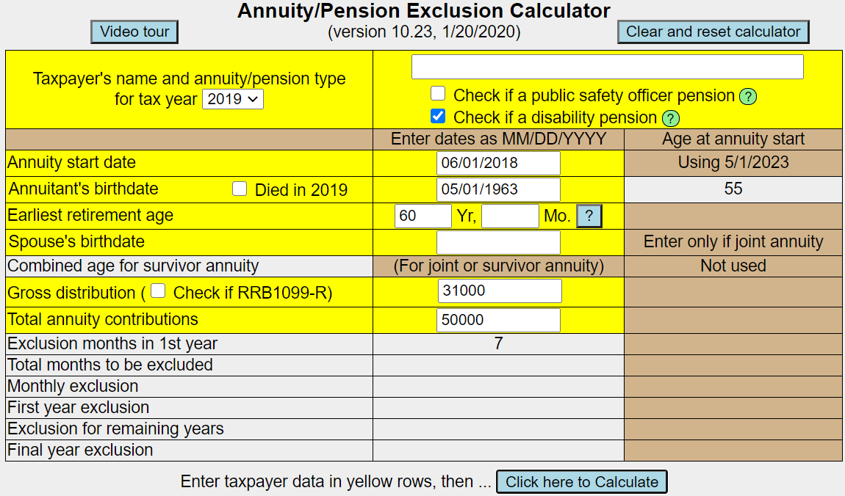
Disability Pension with Employee Federal After-Tax Employee Contributions
Will ask for earliest retire-
ment age if disability pension
box is checked
Notes:
Instructor Note
Be sure to pause so the class can discuss before showing them the answer

Slide 77
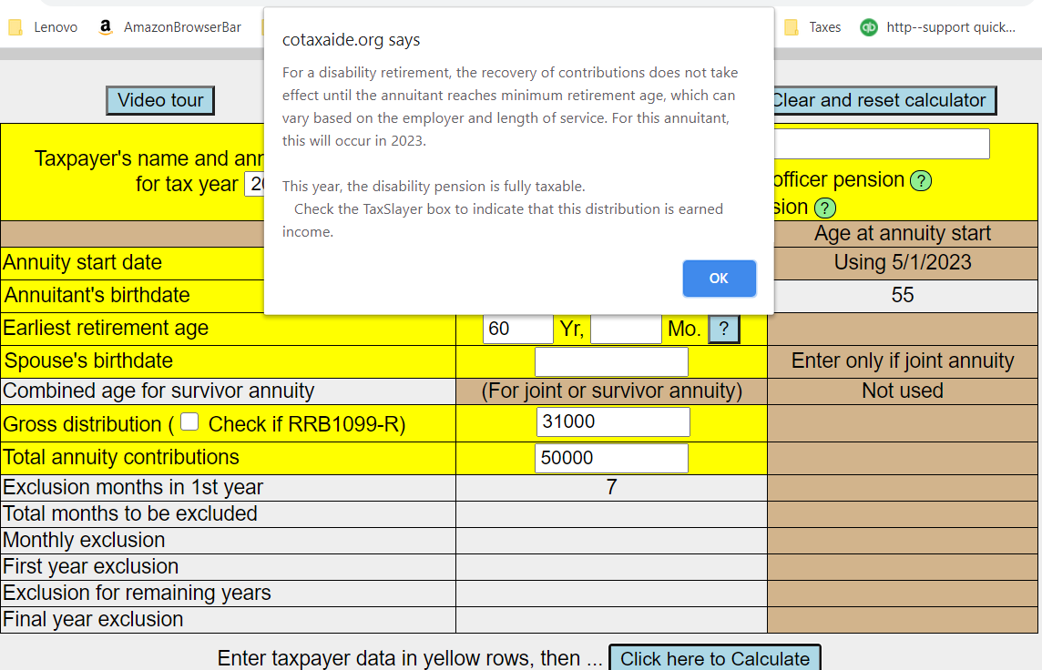
Disability Pension with Employee Federal After-Tax Employee Contributions
Taxable amount in Box 2a
will be same as Gross amount
in Box 1
Notes:
Instructor Note
Be sure to pause so the class can discuss before showing them the answer

Slide 78
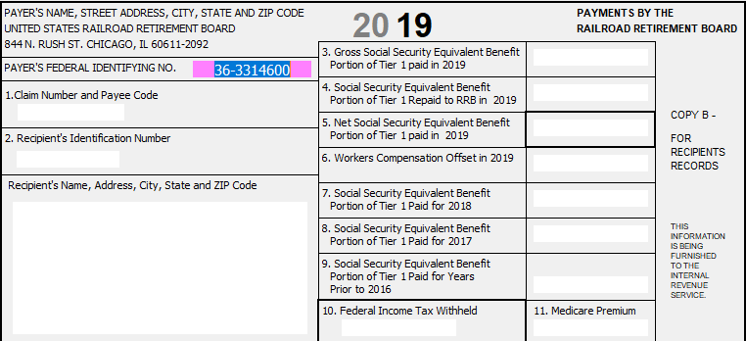
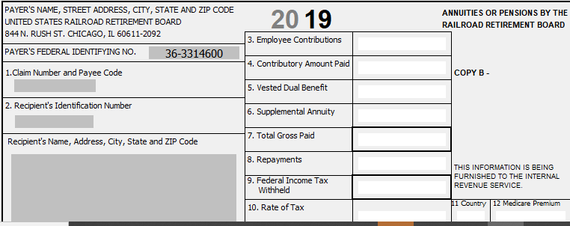
Railroad Retirement Board (RRB) 1099s
Railroad Retirement Board
RRB-1099 Treat like Social Security (blue)
RRB-1099-R Treat like a Form 1099-R (3 copies) (green)
Usually requires the Simplified Method to determine taxable amount

Slide 79
Qualified Charitable Distribution from a Traditional IRA
Qualified charitable distribution (QCD) from a Traditional IRA to a charity
Distribution can be excluded from taxable income
Change taxable amount in Box 2a to subtract QCD
Select QCD box on Nontaxable Distributions screen
Cannot also claim on Schedule A as a charitable contribution
QCD counts towards the taxpayer’s Required Minimum Distribution (RMD)
Notes:
With the increase in standard deductions, some taxpayers may longer be able to itemize. The QCD is a way to use their charitable contributions to reduce their tax. This works well for those large recurring contributions such as to the taxpayer’s church.

Slide 80
Qualified Charitable Distribution Rules
Taxpayer must be at least 70½ when distribution made
IRA trustee must make payment directly to charity
Taxpayer must have acknowledgement from charity of the contribution to claim exclusion
Maximum annual exclusion for a QCD is $100,000
On joint return, both taxpayer and spouse can each have a QCD and exclude up to $100,000 (max total of $200,000)
Notes:
Qualified Charitable Distribution made permanent in Tax Code.

Slide 81
Qualified Charitable Distributions on NJ Return
NJ does not allow qualified charitable distributions to be excluded from taxable income
Must capture distribution amount as a positive Adjustment to Line 20a on NJ Checklist

Slide 82
Enter 1099-R for a Qualified Charitable Distribution from a Traditional IRA
$20,000 of distribution
donated directly to charity;
Taxpayer age 71
X
Original 1099-R shows Box 1 =
Box 2a
Must subtract QCD from Box
2a – now equals $11,000

Slide 83
IRA/Pension Distributions Sub-Menu

Slide 84
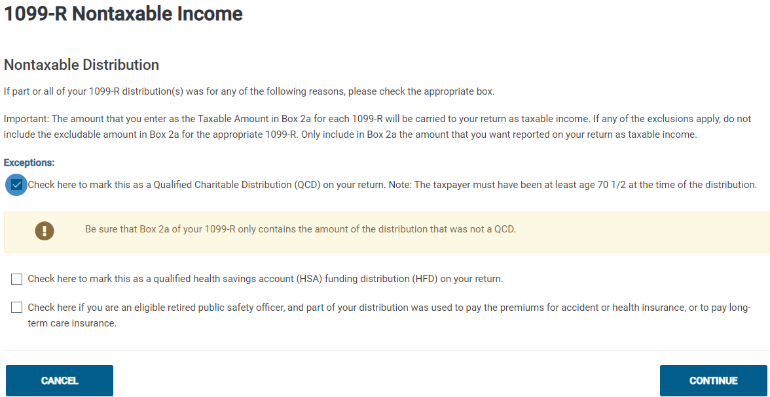
Nontaxable Distributions Screen

Slide 85
Results – Qualified Charitable Distribution

Slide 86
NJ Tax Law Differences & NJ Checklist
Retirement tax law topics that are different for NJ
Disability pension (covered on previous slides)
Military pension
NJ 1040 lines to report retirement income
Separate lines for taxable and excludable amounts (Lines 20a and 20b)
3-year rule
Government pension with Federal pre-tax contributions
IRA with pre-tax contributions
Pension exclusion
Other retirement income exclusion
Qualified Charitable Distributions (covered on previous slides)
Must capture these items on NJ Checklist for entry into TaxSlayer State section
Notes:
Instructor Notes:
These are other areas where NJ tax law differs from Federal tax law regarding retirement income. They will each be discussed on the next slides

Slide 87
Military Pensions
Military pensions (Defense Finance & Accounting SVC) are not taxable in NJ
Amount of military pension will flow through to NJ from Federal 1099-R entry, so must tell TaxSlayer to subtract from NJ taxable income
Capture the amount of the military pension in NJ Checklist Income Subject to Tax section as a negative adjustment to Line 20a

Slide 88
NJ 1040 Lines to Report Retirement Income
Taxable amount of 1099-R distribution reported on NJ 1040 Line 20a Taxable Amounts of IRAs, Pensions, and Annuities
Usually flows through from Federal Box 2a
Excludable amount of 1099-R distribution reported on Line 20b Excludable Amounts of IRAs, Pensions, and Annuities
Must be captured manually on NJ Checklist in Income Subject to Tax section
Do not include distributions that are totally tax-exempt for NJ, such as military and disability pensions and rollovers

Slide 89
NJ Checklist – Adjustments to Line 20b Excludable Amounts of IRAs, Pensions, and Annuities

Slide 90
Two Methods for Determining NJ Taxable and Excludable Amounts of Pension
1) Let taxable amount in Box 2a flow through from Federal to NJ 1040 Line 20a
Calculate excludable amount (Box 1-Box 2a) and note on Adjustments to Line 20b row of NJ Checklist
2) If eligible, use 3-Year Rule method (see next slide for eligibility)
Full distribution amount is excludable and reported on Line 20b until all contributions are recovered
After all contributions are recovered, distribution is fully taxable and reported on Line 20a
Notes:
Instructor Notes:
Discuss why the 3-Year Rule is more beneficial for taxpayer if eligible – don’t have to pay tax on all contributions up front, rather than over the course of your remaining life

Slide 91
3-Year Rule Method
You may use 3-Year Rule method if:
You will recover all your contributions within 36 months from date you receive first payment from plan
Both you and your employer contributed to plan
See NJ Special Handling document to help calculate amounts to put on NJ Checklist if using 3-Year Rule
Notes:
Instructor Note
Be sure to pause so the class can discuss before showing them the answer

Slide 92
Pensions with Federal Pre-Tax Contributions
Most commonly, these are government pensions received from NJ Division of Pensions and Benefits
E.g. – state employees, teachers, etc.
Contributions are pre-tax for Federal
Therefore, distributions are usually fully taxable on Federal return
Taxable amount could be slightly less than gross amount due to pre-1987 after-tax contributions (small amount in Box 9b)

Slide 93
Pensions with Federal Pre-Tax Contributions
cont’d
All contributions are after-tax for NJ; therefore, the taxability of distribution for NJ return will be different than the Federal
Calculate the taxable and excludable amounts for NJ by using the Bogart Annuity calculator
Must use total amount of pension contributions, not amount in Box 9b which is just Federal after-tax contributions
Taxpayer received a letter with this info when pension started. Can also call Division of Pensions and Benefits to obtain
May not have large impact on NJ bottom line since NJ pension exclusion has increased to $80K (MFJ) for 2019 (discussed on later slides)

Slide 94
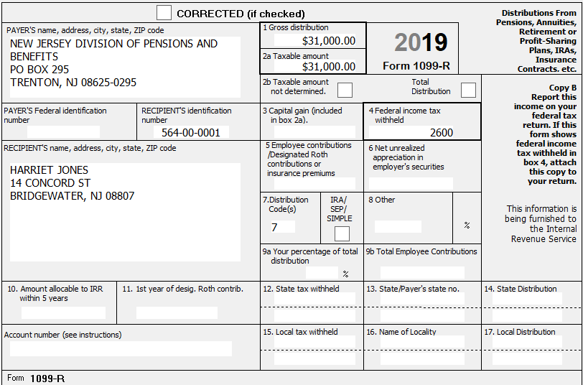
NJ Government Pension with Federal Pre-Tax Contributions; After-Tax for NJ
Total employee pension contributions $50,000
Notes:
Instructor Notes:
This is a pension from the NJ Division of Pensions and Benefits that had Federal pre-tax pension contributions
Pension from New Jersey Division of Pensions and Benefits gives you a clue to ask taxpayer if pre-tax contributions were made

Slide 95
Simplified Method Calculation Using Bogart Annuity Calculator to Determine NJ Taxable Amount

Slide 96
Simplified Method Calculation Using Bogart Annuity Calculator to Determine NJ Taxable Amount

Slide 97
NJ Checklist to Adjust for NJ After-Tax Pension Contributions
Calculate the amount needed to adjust NJ 1040 Line 20a
Box 2a Federal taxable amount (flows thru from Federal) minus
Calculated taxable amount from Bogart Calculator
Note the negative Adjustment to Line 20a on the NJ Checklist
Note the excludable amount from Bogart Annuity Calculator as a positive Adjustment to Line 20b on the NJ Checklist
$31,000 minus
$29,333
- $1,667
+$1,667

Slide 98
IRAs, 403b, 457b, Thrift Savings Plans
Distributions from IRAs, 403b, 457b, and Thrift Savings Plans (TSPs) are taxed in NJ except for the portion that represents taxpayer contributions
Contributions were made with after-tax money for NJ, so not taxed upon distribution
To determine NJ taxable amount of any of these distributions, the portion of the distribution that represents taxpayer contributions is allocated over expected number of distribution months

Slide 99
IRAs, 403b, 457b, Thrift Savings Plans
Taxpayer must know total contributions
May be able to get info for some of these plans from NJ Division of Pensions and Benefits or from plan administrator
Taxpayers would have to know IRA contributions from their own records
Use NJ IRA Worksheet on TaxPrep4Free.org to determine the taxable and nontaxable amounts (if contributions are known, which is uncommon)

Slide 100
NJ Pension Exclusion – Eligibility Requirements
You &/or spouse/CU partner 62 years+ or blind or disabled (according to SSA guidelines) on last day of year
If only 1 partner qualifies, can still claim up to maximum pension exclusion. However, only retirement income of qualified partner can be excluded
TaxSlayer will know if the taxpayer or spouse is disabled based on answer to disability question in Basic Information section of NJ return
Total income from NJ 1040 Line 29 $100K or less

Slide 101
NJ Pension Exclusion
Amount that can be excluded is based on filing status:
$80K – MFJ
$60K – Single, HOH, QW
$40K – MFS
Maximum exclusion cannot exceed amount on NJ 1040 Line 20a (Taxable Amounts of IRAs, Pensions and Annuities)
Notes:
Instructor Notes:
Pension exclusion claimed on NJ 1040 Line 28a may be less than the maximum exclusion because total Pension, Annuity & IRA Withdrawal amount on Line 20a is less than the maximum

Slide 102
Other Retirement Income Exclusions - NJ1040 Line 28b
2 Parts to Other Retirement Income Exclusions
Unclaimed portion of your Pension Exclusion
Special exclusion for taxpayers who are unable to receive SS or RR benefits
Each part has different eligibility requirements

Slide 103
Other Retirement Income Exclusions: Unclaimed Pension Exclusion Eligibility Requirements
Did not use maximum Pension Exclusion
You &/or spouse/CU partner 62 years or older
Total income from NJ 1040 Line 29 $100K or less
Income from wages, net profit from business, partnership, S corp. income </= $3K
Amount will be maximum pension exclusion minus pension exclusion claimed on NJ 1040 Line 28a
Notes:
Instructor Notes:
Income from wages, net profit from business is made up of NJ 1040 Lines 15+18+21+22

Slide 104
NJ Other Retirement Income Exclusions: For Taxpayers Unable to Receive SS/RR Benefits – Eligibility Requirements
Not related to Pension Exclusion & may claim whether or not you use maximum Pension Exclusion
Exclusion amounts $6K – MFJ, HOH, QW; $3K – Single, MFS
You &/or spouse/CU partner 62 years or older
Unable to receive SS/RR benefits, but would have been eligible for benefits had you fully participated in either program
Must answer questions under Pension Exclusion in State section \ Edit \ Enter Myself \ Subtractions from Income for TaxSlayer to determine eligibility

Slide 105
NJ Subtractions from Income Section under Pension Exclusion

Slide 106
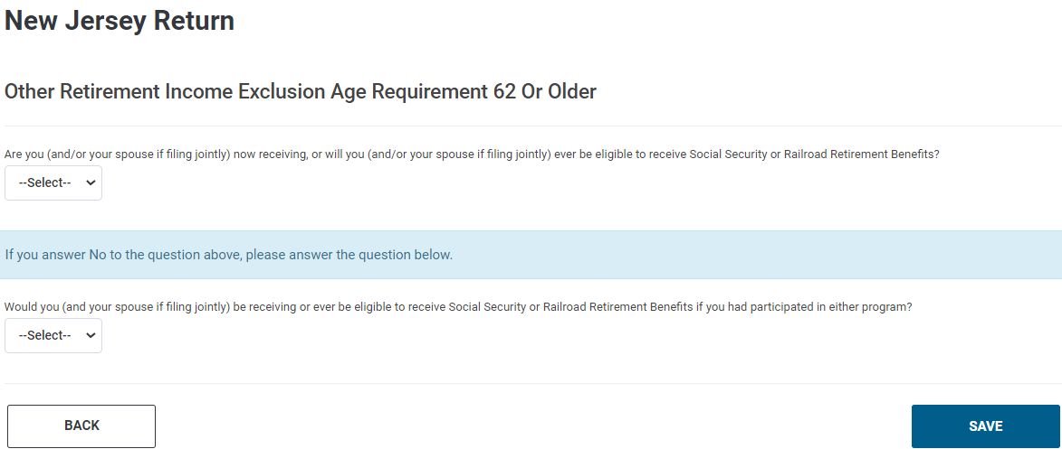
Other Retirement Income Exclusion Questions

